Slide 1
Paper Review-
“A Modified LeNet CNN for Breast Cancer Diagnosis in Ultrasound Images”
Tasnim Fuyara Chhoan(ID: 23366035)
CSE707 DIstributed Computing System
Mehnaz Ara Faizul (ST)
Humaion Kabir Mehedi (RA)
Submitted to : Annajiat Alim Rasel
Group 41

Slide 2
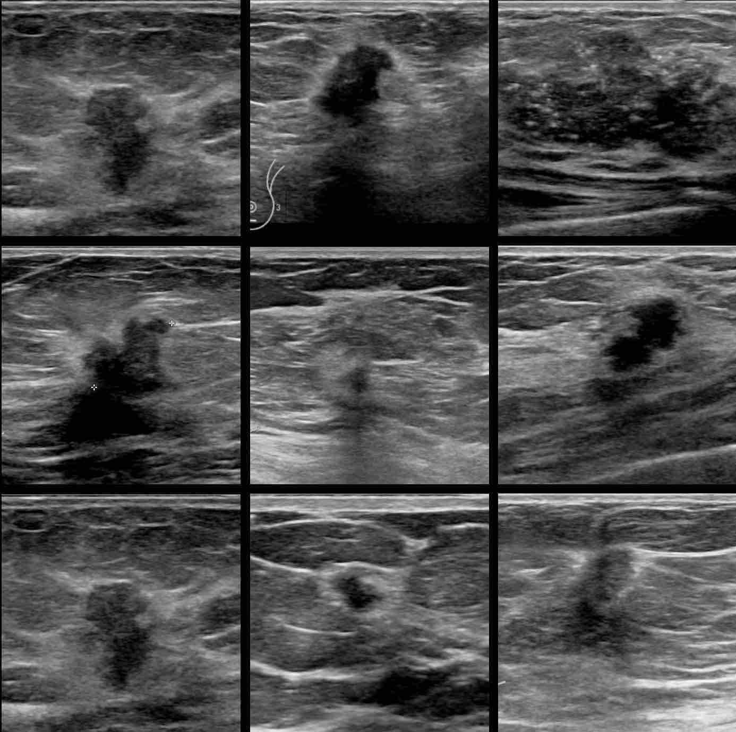
Table of Content
Summary
Motivation
Contribution
Methodology
Conclusion
Limitations
First Limitation
Second Limitation
Synthesis

Slide 3
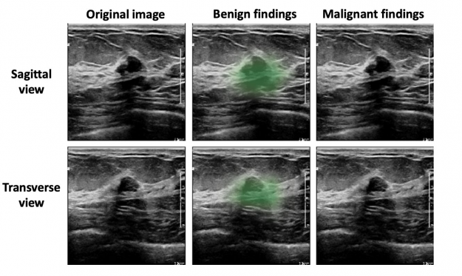
Summary
Motivation
Advanced breast cancer prediction accuracy.
Explore ensemble methods, specifically ensembled LeNet CNN.

Slide 4
Summary
Contribution
Develop a modified LeNet model.
Surpass existing architectures in accuracy.
Offer a systematic approach integrating ensemble techniques, hyperparameter tuning, and rigorous data preprocessing.

Slide 5
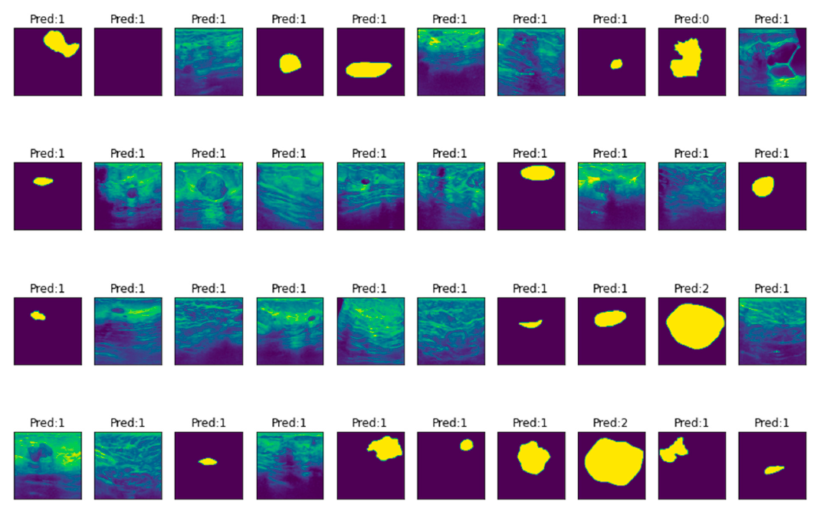
Summary
Methodology
Meticulous preprocessing of BUS dataset.
Train multiple LeNet CNN models with diverse settings.
Ensemble methods, ReLU activation, and 40% dropout enhance the model.
Soft voting and early stopping for robustness.
Emphasize the importance of ensemble methods, hyperparameter optimization, and data preprocessing.

Slide 6
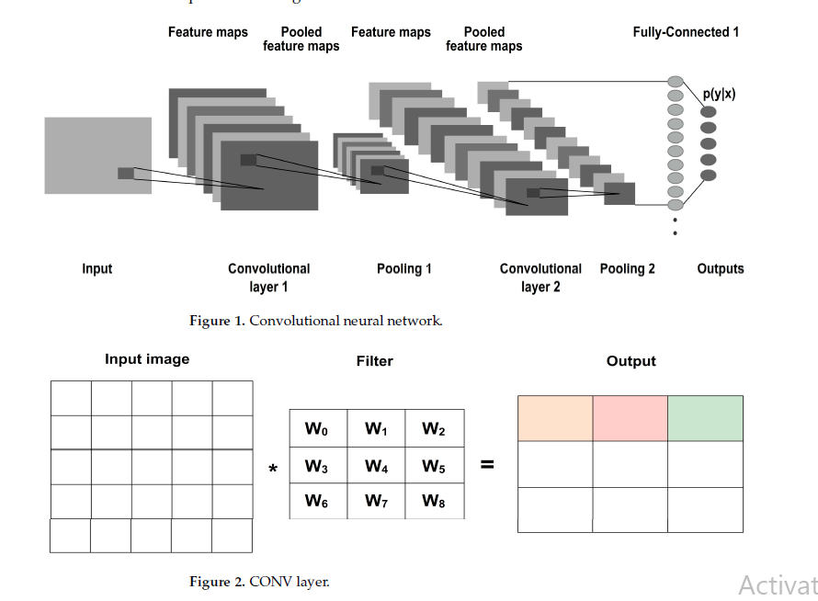
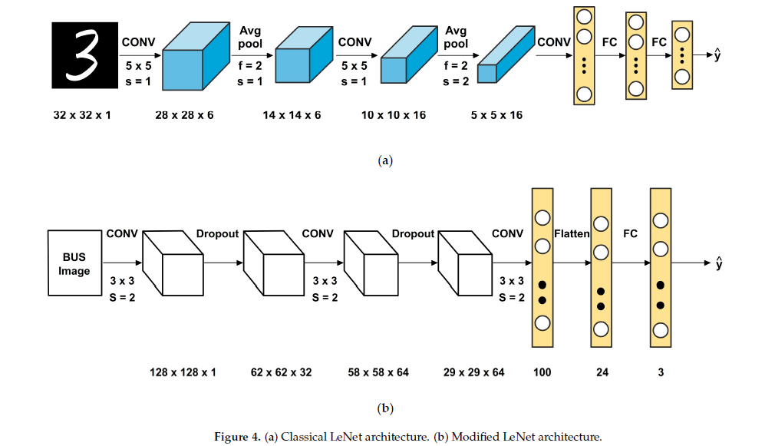
Summary
Methodology

Slide 7
Summary
Conclusion
Successfully demonstrate the superiority of the ensembled LeNet model.
Achieve commendable accuracy, precision, recall, and F1 score.
Affirm the significance of ensemble methods and hyperparameter tuning.
Set the stage for future advancements in medical image classification.

Slide 8
Limitations
First Limitation
Second Limitation
Dataset size and representativeness.
May constrain model generalizability.
Sensitivity of hyperparameter tuning.
Raises concerns about stability and generalizability.

Slide 9
Synthesis
Synthesis
Introduce a novel approach using an ensembled LeNet CNN for breast cancer prediction.
Formulate an ensemble of thirteen LeNet models, surpassing individual architectures.
Contribution extends to exploring ensemble methods in medical imaging.

Slide 10
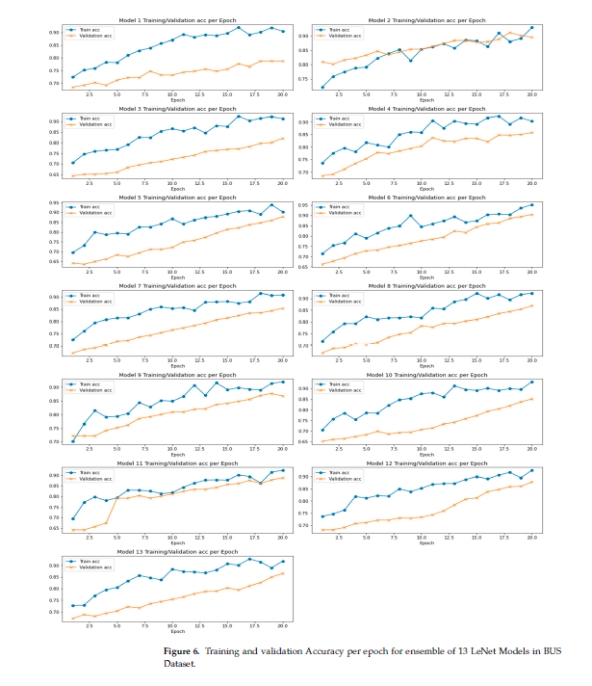
Synthesis
Synthesis
Achieve 89.91% accuracy, outperforming traditional LeNet and other CNNs.
Acknowledge limitations and emphasize future applications in computer-aided diagnosis.

Slide 11
Reference
Balasubramaniam, S., Velmurugan, Y., Jaganathan, D., & Dhanasekaran, S. (2023). A Modified LeNet CNN for Breast Cancer Diagnosis in Ultrasound Images. Diagnostics, 13(17), 2746. https://doi.org/10.3390/diagnostics13172746

